Slide 1

Unit IV (Memory and I/O Management) - Syllabus
Memory Management
Memory Management Requirements, Memory Partitioning: Fixed Partitioning, Dynamic Partitioning, Buddy System, Relocation, Paging, Segmentation.
I/O Management
I/O Devices, Organization of the I/O Function, I/O Buffering, Disk Scheduling (FIFO, SSTF, SCAN, C-SCAN, LOOK, C-LOOK)
Department of Information Technology, VIIT, Pune-48
Notes:
The traditional approach of a single thread of execution per process, in which the concept of a thread is not recognized, is referred to as a single-threaded approach. The two arrangements shown in the left half of Figure 4.1 are single-threaded approaches. MS-DOS is an example of an OS that supports a single user process and a single thread.

Slide 2
Memory Management
Is the task carried out by the OS and hardware to accommodate multiple processes in main memory
If only a few processes can be kept in main memory, then much of the time all processes will be waiting for I/O and the CPU will be idle
Hence, memory needs to be allocated efficiently in order to pack as many processes into memory as possible
In most schemes, the kernel occupies some fixed portion of main memory and the rest is shared by multiple processes
Department of Information Technology, VIIT, Pune-48

Slide 3
Memory Management Requirements
Relocation
programmer cannot know where the program will be placed in memory when it is executed
a process may be (often) relocated in main memory due to swapping
swapping enables the OS to have a larger pool of ready-to-execute processes
memory references in code (for both instructions and data) must be translated to actual physical memory address
Department of Information Technology, VIIT, Pune-48

Slide 4
Memory Management Requirements
Protection
processes should not be able to reference memory locations in another process without permission
impossible to check addresses at compile time in programs since the program could be relocated
address references must be checked at run time by hardware
Department of Information Technology, VIIT, Pune-48

Slide 5
Memory Management Requirements
Sharing
must allow several processes to access a common portion of main memory without compromising protection
cooperating processes may need to share access to the same data structure
better to allow each process to access the same copy of the program rather than have their own separate copy
Department of Information Technology, VIIT, Pune-48

Slide 6
Memory Management Requirements
Logical Organization
users write programs in modules with different characteristics
instruction modules are execute-only
data modules are either read-only or read/write
some modules are private others are public
To effectively deal with user programs, the OS and hardware should support a basic form of module to provide the required protection and sharing
Department of Information Technology, VIIT, Pune-48

Slide 7
Memory Management Requirements
Physical Organization
secondary memory is the long term store for programs and data while main memory holds program and data currently in use
moving information between these two levels of memory is a major concern of memory management (OS)
it is highly inefficient to leave this responsibility to the application programmer
Department of Information Technology, VIIT, Pune-48

Slide 8
Simple Memory Management
Here we study the simpler case where there is no virtual memory
An executing process must be loaded entirely in main memory
Although the following simple memory management techniques are not used in modern OS, they lay the ground for a proper discussion of virtual memory
fixed partitioning
dynamic partitioning
simple paging
simple segmentation
Department of Information Technology, VIIT, Pune-48

Slide 9
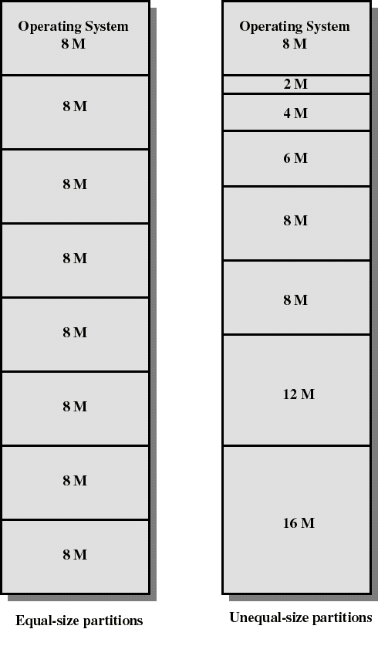
Fixed Partitioning
Partition main memory into a set of non overlapping regions called partitions
Partitions can be of equal or unequal sizes
Department of Information Technology, VIIT, Pune-48

Slide 10
Fixed Partitioning
Any process whose size is less than or equal to a partition size can be loaded into the partition
If all partitions are occupied, the operating system can swap a process out of a partition
A program may be too large to fit in a partition. The programmer must then design the program with overlays (“The process of transferring a block of program code or other data into internal memory, replacing what is already stored”. )
when the module needed is not present, the user program must load that module into the program’s partition, overlaying whatever program or data are there
Department of Information Technology, VIIT, Pune-48

Slide 11
Fixed Partitioning
Main memory use is inefficient. Any program, no matter how small, occupies an entire partition. This is called internal fragmentation.
Unequal-size partitions lessens these problems but they still remain...
Equal-size partitions was used in early IBM’s OS/MFT (Multiprogramming with a Fixed number of Tasks)
Department of Information Technology, VIIT, Pune-48

Slide 12
Placement Algorithm with Partitions
Equal-size partitions
If there is an available partition, a process can be loaded into that partition
because all partitions are of equal size, it does not matter which partition is used
If all partitions are occupied by blocked processes, choose one process to swap out to make room for the new process
Department of Information Technology, VIIT, Pune-48

Slide 13
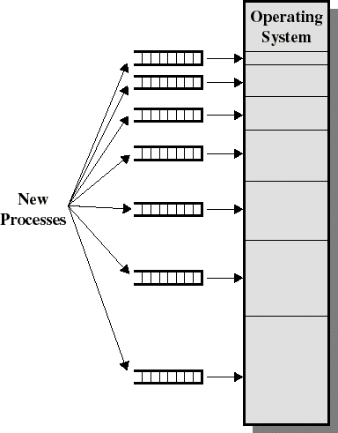
Placement Algorithm with Partitions
Unequal-size partitions: use of multiple queues
assign each process to the smallest partition within which it will fit
A queue for each partition size is maintained
tries to minimize internal fragmentation
Problem: some queues will be empty if no processes within a size range is present
Department of Information Technology, VIIT, Pune-48

Slide 14
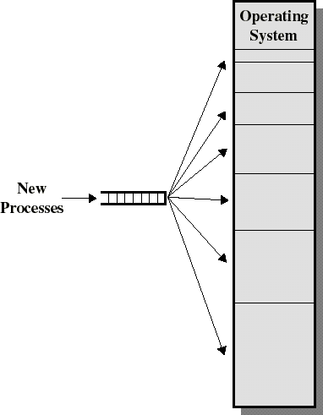
Placement Algorithm with Partitions
Unequal-size partitions: use of a single queue
When its time to load a process into main memory the smallest available partition that will hold the process is selected
increases the level of multiprogramming at the expense of internal fragmentation
Department of Information Technology, VIIT, Pune-48

Slide 15
Dynamic Partitioning
Partitions are of variable length and number
Each process is allocated exactly as much memory as it requires
Eventually holes are formed in main memory. This is called external fragmentation
Must use compaction to shift processes so they are contiguous and all free memory is in one block
Used in IBM’s OS/MVT (Multiprogramming with a Variable number of Tasks)
Department of Information Technology, VIIT, Pune-48

Slide 16
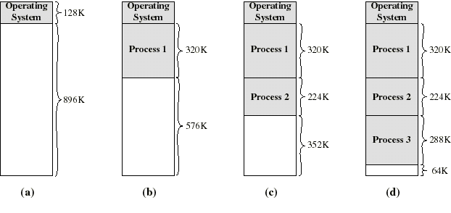
Dynamic Partitioning: an example
A hole of 64K is left after loading 3 processes: not enough room for another process
Eventually each process is blocked. The OS swaps out process 2 to bring in process 4
Department of Information Technology, VIIT, Pune-48

Slide 17
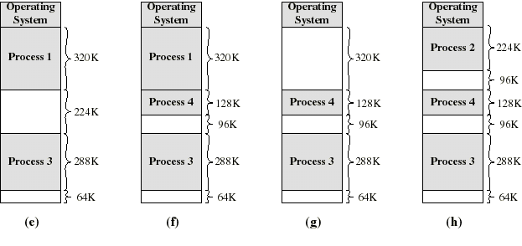
Dynamic Partitioning: an example
another hole of 96K is created
Eventually each process is blocked. The OS swaps out process 1 to bring in again process 2 and another hole of 96K is created...
Compaction would produce a single hole of 256K
Department of Information Technology, VIIT, Pune-48

Slide 18
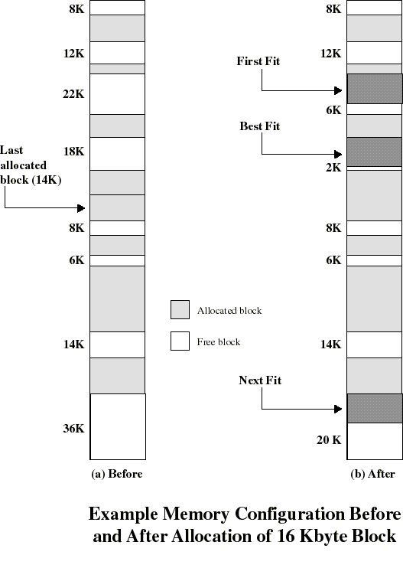
Placement Algorithm
Used to decide which free block to allocate to a process
Goal: to reduce usage of compaction (time consuming)
Possible algorithms:
Best-fit: choose smallest hole
First-fit: choose first hole from beginning
Next-fit: choose first hole from last placement
Department of Information Technology, VIIT, Pune-48

Slide 19
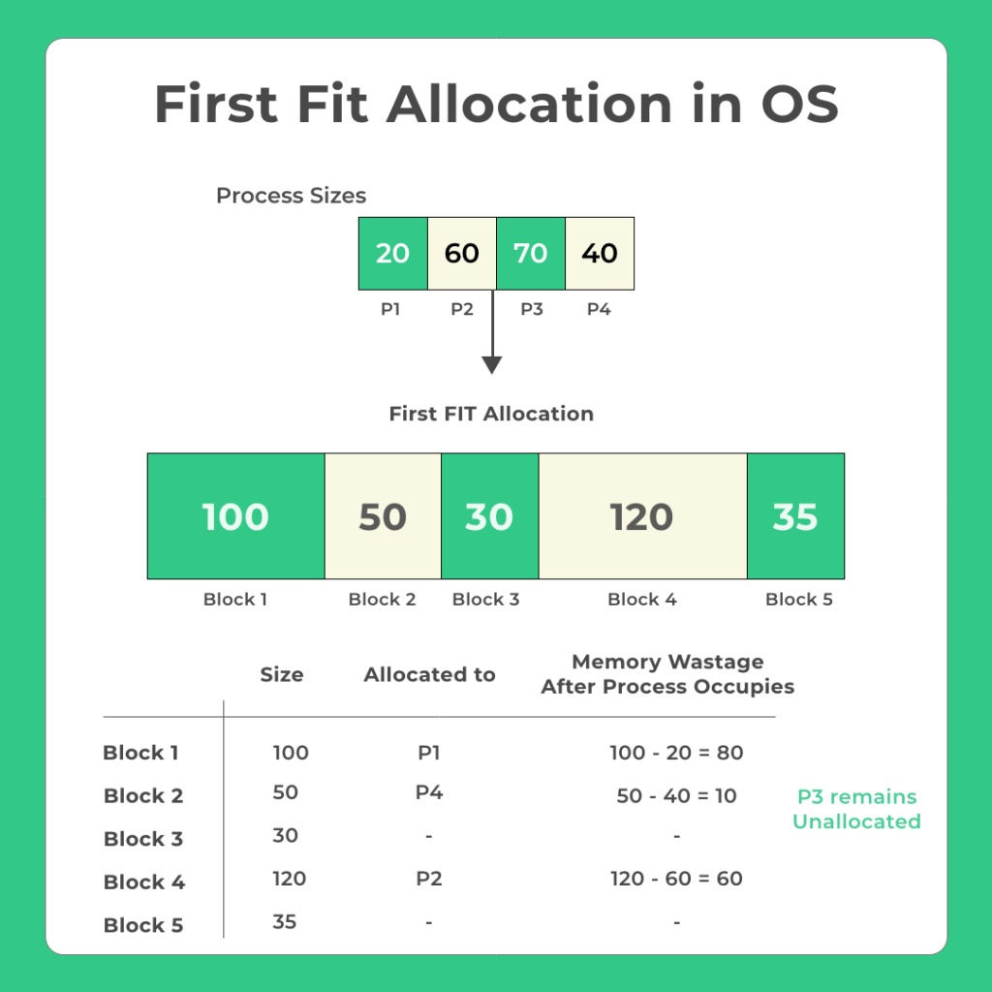
Partition Allocation Algorithm – First fit
Whenever a process (p1) comes with memory allocation request the following happens –
OS sequentially searches available memory blocks from the first index
Assigns the first memory block large enough to accommodate process
Whenever a new process P2 comes, it does the same thing. Search from the first index again.
Department of Information Technology, VIIT, Pune-48

Slide 20
Partition Allocation Algorithm – Next fit
Next-fit: choose first hole from last placement
Step 1. Enter the number of memory blocks.
Step 2. Enter the size of each memory block.
Step 3. Enter the number of processes with their sizes.
Step 4. Carry out search from the last allocated memory location.
Step 6. If the current memory size is smaller, then continue to check the next blocks.
Step 7. Stop
Department of Information Technology, VIIT, Pune-48

Slide 21
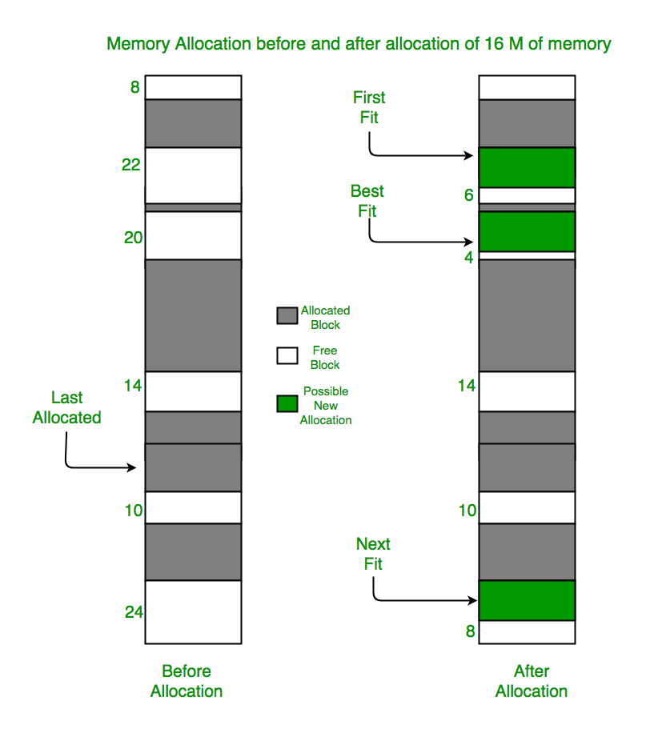
Partition Allocation Algorithm – Next fit
Department of Information Technology, VIIT, Pune-48

Slide 22
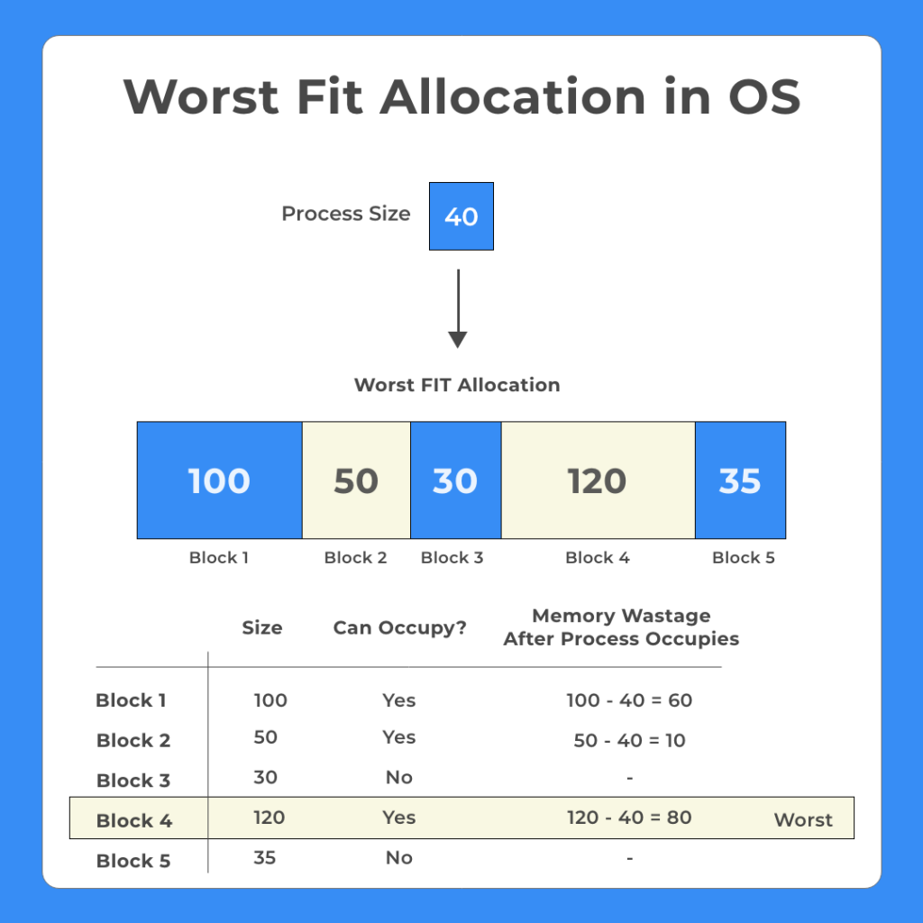
Partition Allocation Algorithm – Worst fit
The algorithms searches sequentially starting from first memory block and searches for the memory block that fulfills the following condition –
Can accommodate the process size
Leaves the largest wasted space (fragmentation) after the process is allocated to given memory block
Department of Information Technology, VIIT, Pune-48

Slide 23
Partition Allocation Algorithm – Worst fit
Step 1: Input memory block with a size.
Step 2: Input process with size.
Step 3: Initialize by selecting each process to find the maximum block size that can be assigned to the current process.
Step 4: If the condition does not fulfill, they leave the process.
Step 5: If the condition is not fulfilled, then leave the process and check for the next process.
Step 6: Stop.
Department of Information Technology, VIIT, Pune-48

Slide 24
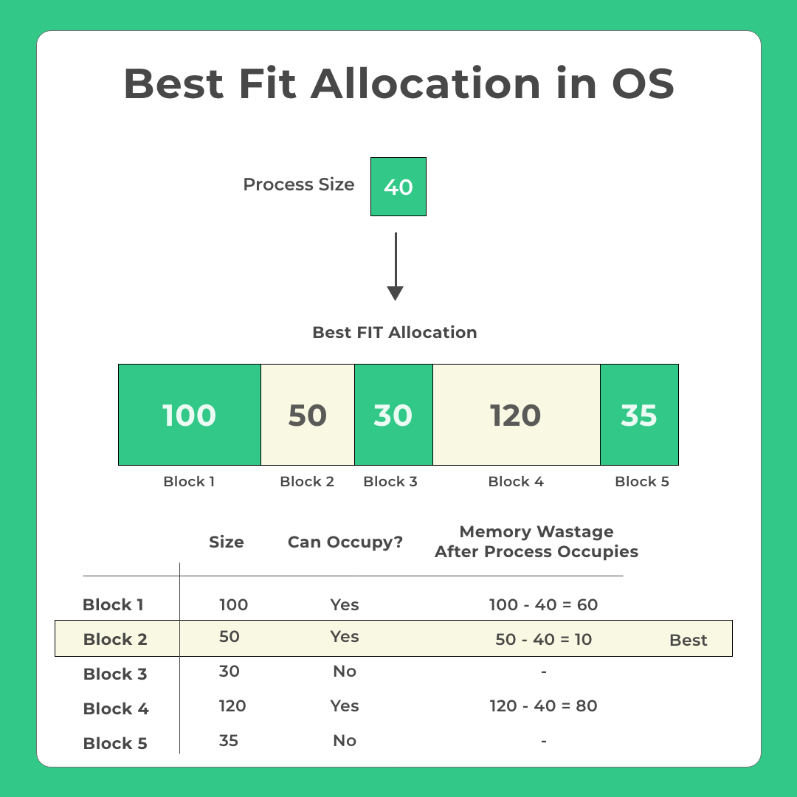
Partition Allocation Algorithm – Best fit
In Best fit memory allocation scheme, the operating system searches that can –
Accommodate the process
Also, leaves the minimum memory wastage
The process size is 40.
While blocks 1, 2 and 4 can accommodate the process.
Block 2 is chosen, as it leaves the lowest memory wastage
Department of Information Technology, VIIT, Pune-48

Slide 25
Placement Algorithm: comments
Next-fit often leads to allocation of the largest block at the end of memory
First-fit favors allocation near the beginning: tends to create less fragmentation then Next-fit
Best-fit searches for smallest block: the fragment left behind is small as possible
main memory quickly forms holes too small to hold any process: compaction generally needs to be done more often
Department of Information Technology, VIIT, Pune-48

Slide 26
Buddy System
Allocates memory from fixed-size segment consisting of physically-contiguous pages
Memory allocated using power-of-2 allocator
Satisfies requests in units sized as power of 2
Request rounded up to next highest power of 2
When smaller allocation needed than is available, current chunk split into two buddies of next-lower power of 2
Continue until appropriate sized chunk available
For example, assume 256KB chunk available, kernel requests 21KB
Split into A_{L} _{and} A_{R} of 128KB each
One further divided into B_{L} and B_{R} of 64KB
One further into C_{L} and C_{R} of 32KB each – one used to satisfy request
Advantage – quickly coalesce unused chunks into larger chunk
Disadvantage - fragmentation

Slide 27
Buddy System Allocator

Slide 28
Buddy System Allocator
Given : Memory size = 1MB
Request A →100k, Request A →240k, Request A →64k, Request A →256k,Release B, Release A, Request E →75k, Release C, Release E, Release D
1 MB
512 512
Request A →100k
128 128 512
100 128 512
Fragmentation of 28 k

Slide 29
Buddy System Allocator

Slide 30
Replacement Algorithm
When all processes in main memory are blocked, the OS must choose which process to replace
A process must be swapped out (to a Blocked-Suspend state) and be replaced by a new process or a process from the Ready-Suspend queue
We will discuss later such algorithms for memory management schemes using virtual memory
Department of Information Technology, VIIT, Pune-48

Slide 31
Relocation
Because of swapping and compaction, a process may occupy different main memory locations during its lifetime
Hence physical memory references by a process cannot be fixed
This problem is solved by distinguishing between logical address and physical address
Department of Information Technology, VIIT, Pune-48

Slide 32
Address Types
A physical address (absolute address) is a physical location in main memory
A logical address is a reference to a memory location independent of the physical structure/organization of memory
Compilers produce code in which all memory references are logical addresses
A relative address is an example of logical address in which the address is expressed as a location relative to some known point in the program (ex: the beginning)
Department of Information Technology, VIIT, Pune-48

Slide 33
Address Translation
Relative address is the most frequent type of logical address used in pgm modules (ie: executable files)
Such modules are loaded in main memory with all memory references in relative form
Physical addresses are calculated “on the fly” as the instructions are executed
For adequate performance, the translation from relative to physical address must by done by hardware
Department of Information Technology, VIIT, Pune-48

Slide 34
Simple example of hardware translation of addresses
When a process is assigned to the running state, a base register (in CPU) gets loaded with the starting physical address of the process
A bound register gets loaded with the process’s ending physical address
When a relative addresses is encountered, it is added with the content of the base register to obtain the physical address which is compared with the content of the bound register
This provides hardware protection: each process can only access memory within its process image
Department of Information Technology, VIIT, Pune-48

Slide 35
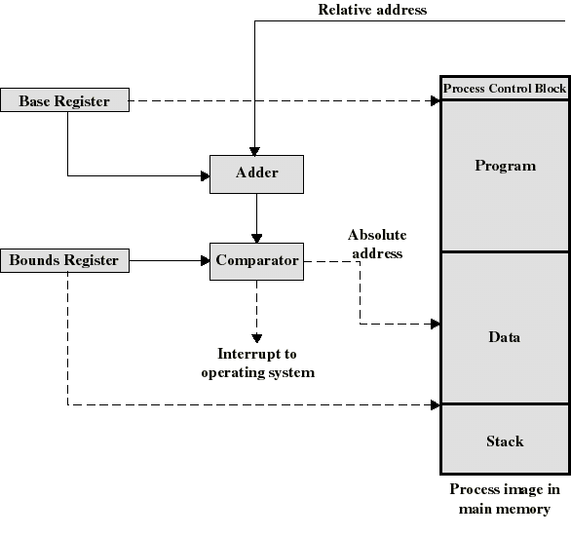
Example Hardware for Address Translation
Department of Information Technology, VIIT, Pune-48

Slide 36
Simple Paging
Main memory is partition into equal fixed-sized chunks (of relatively small size)
Trick: each process is also divided into chunks of the same size called pages
The process pages can thus be assigned to the available chunks in main memory called frames (or page frames)
Consequence: a process does not need to occupy a contiguous portion of memory
Department of Information Technology, VIIT, Pune-48

Slide 37
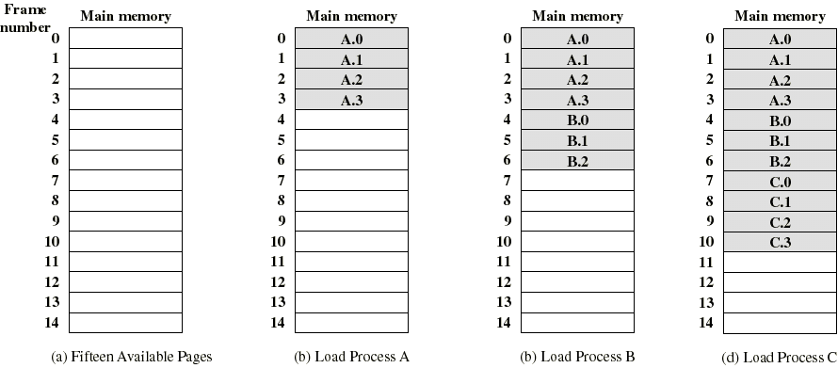
Example of process loading
Now suppose that process B is swapped out
Department of Information Technology, VIIT, Pune-48

Slide 38
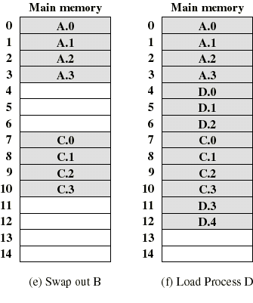
Example of process loading (cont.)
When process A and C are blocked, the pager loads a new process D consisting of 5 pages
Process D does not occupied a contiguous portion of memory
There is no external fragmentation
Internal fragmentation consist only of the last page of each process
Department of Information Technology, VIIT, Pune-48

Slide 39
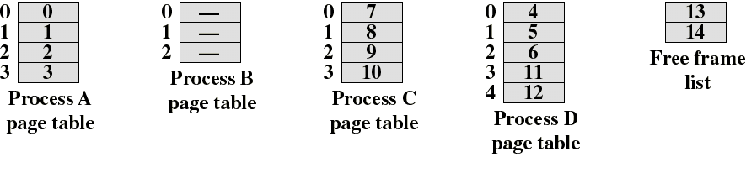
Page Tables
The OS now needs to maintain (in main memory) a page table for each process
Each entry of a page table consist of the frame number where the corresponding page is physically located
The page table is indexed by the page number to obtain the frame number
A free frame list, available for pages, is maintained
Department of Information Technology, VIIT, Pune-48

Slide 40
Logical address used in paging
Within each program, each logical address must consist of a page number and an offset within the page
A CPU register always holds the starting physical address of the page table of the currently running process
Presented with the logical address (page number, offset) the processor accesses the page table to obtain the physical address (frame number, offset)
Department of Information Technology, VIIT, Pune-48

Slide 41
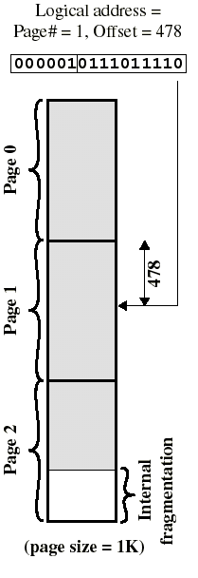
Logical address in paging
The logical address becomes a relative address when the page size is a power of 2
Ex: if 16 bits addresses are used and page size = 1K, we need 10 bits for offset and have 6 bits available for page number
Then the 16 bit address obtained with the 10 least significant bit as offset and 6 most significant bit as page number is a location relative to the beginning of the process
Department of Information Technology, VIIT, Pune-48

Slide 42
Logical address in paging
By using a page size of a power of 2, the pages are invisible to the programmer, compiler/assembler, and the linker
Address translation at run-time is then easy to implement in hardware
logical address (n,m) gets translated to physical address (k,m) by indexing the page table and appending the same offset m to the frame number k
Department of Information Technology, VIIT, Pune-48

Slide 43
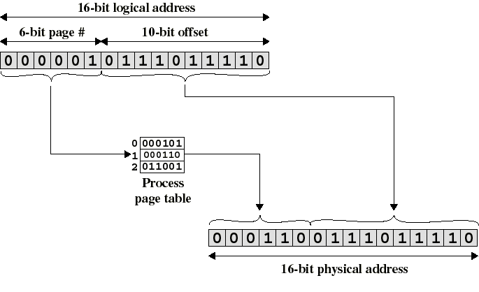
Logical-to-Physical Address Translation in Paging
Department of Information Technology, VIIT, Pune-48

Slide 44
Simple Segmentation
In Operating Systems, Segmentation is a memory management technique in which the memory is divided into the variable size parts.
When a process gets loaded into main memory, its different segments can be located anywhere
The details about each segment are stored in a table called a segment table. Segment table is stored in one (or many) of the segments.
Each segment is fully packed with instructsion/data: no internal fragmentation
Segmentation gives user’s view of the process which paging does not give
Department of Information Technology, VIIT, Pune-48

Slide 45
Why Segmentation is required?
Paging is more close to the Operating system rather than the User.
It divides all the processes into the form of pages regardless of the fact that a process can have some relative parts of functions which need to be loaded in the same page.
Operating system doesn't care about the User's view of the process.
It may divide the same function into different pages and those pages may or may not be loaded at the same time into the memory.
Paging decreases the efficiency of the system.
segmentation which divides the process into the segments.
Each segment contains the same type of functions such as the main function can be included in one segment and the library functions can be included in the other segment.
Department of Information Technology, VIIT, Pune-48

Slide 46
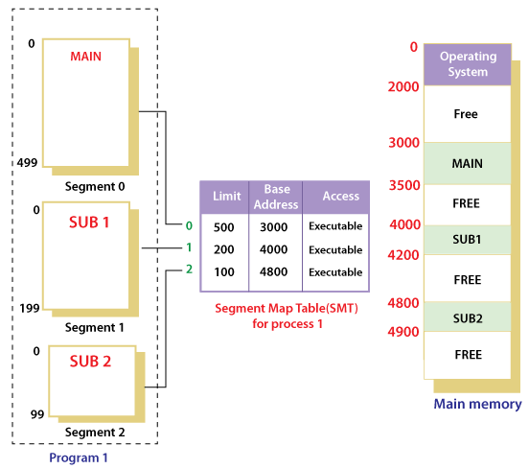
Why Segmentation is required?
Department of Information Technology, VIIT, Pune-48

Slide 47
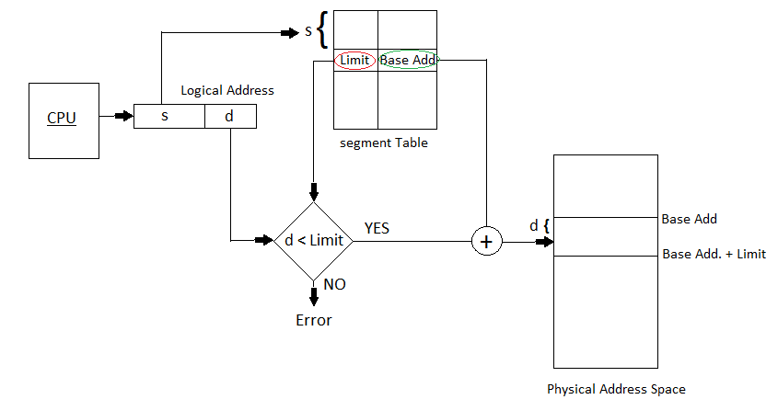
Why Segmentation is required?
Department of Information Technology, VIIT, Pune-48

Slide 48
Why Segmentation is required?
Sr No. | Paging | Segmentation
1 | Non-Contiguous memory allocation | Non-contiguous memory allocation
2 | Paging divides program into fixed size pages. | Segmentation divides program into variable size segments.
3 | OS is responsible | Compiler is responsible.
4 | Paging is faster than segmentation | Segmentation is slower than paging
5 | Paging is closer to OS | Segmentation is closer to User
6 | Logical address is divided into page number and page offset | Logical address is divided into segment number and segment offset
7 | Page table is used to maintain the page information. | Segment Table maintains the segment information
Department of Information Technology, VIIT, Pune-48

Slide 49
Simple Segmentation
Segment table contains mainly two information about segment:
Base: It is the base address of the segment
Limit: It is the length of the segment.
Department of Information Technology, VIIT, Pune-48

Slide 50
Simple Segmentation
In contrast with paging, segmentation is visible to the programmer
provided as a convenience to organize logically programs (ex: data in one segment, code in another segment)
must be aware of segment size limit
The OS maintains a segment table for each process. Each entry contains:
the starting physical addresses of that segment.
the length of that segment (for protection)
Department of Information Technology, VIIT, Pune-48

Slide 51
Logical address used in segmentation
When a process enters the Running state, a CPU register gets loaded with the starting address of the process’s segment table.
Presented with a logical address (segment number, offset) = (n,m), the CPU indexes (with n) the segment table to obtain the starting physical address k and the length l of that segment
The physical address is obtained by adding m to k (in contrast with paging)
the hardware also compares the offset m with the length l of that segment to determine if the address is valid
Department of Information Technology, VIIT, Pune-48

Slide 52
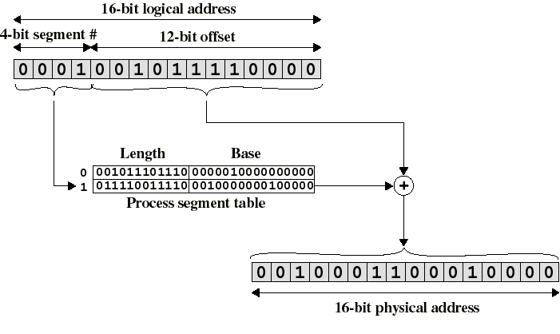
Logical-to-Physical Address Translation in segmentation
Department of Information Technology, VIIT, Pune-48

Slide 53
Simple segmentation and paging comparison
Segmentation requires more complicated hardware for address translation
Segmentation suffers from external fragmentation
Paging only yield a small internal fragmentation
Segmentation is visible to the programmer whereas paging is transparent
Segmentation can be viewed as commodity offered to the programmer to organize logically a program into segments and using different kinds of protection (ex: execute-only for code but read-write for data)
for this we need to use protection bits in segment table entries
Department of Information Technology, VIIT, Pune-48

Slide 54
I/O Management
I/O management is another important function of OS
I/O Requests are managed by Device Drivers in collaboration with some system programs inside the I/O device.
I/O devices can be mainly divided into 4 categories:
Storage Category: disks and tapes are examples of this category
Transmission Category: network cards and modems
Human-interface Category: Screens, keyboards, and mike are human-interface devices for input/output operations
Specialized Category: There are also some other devices like joysticks
Department of Information Technology, VIIT, Pune-48

Slide 55
Disk Scheduling Algorithms
A Process makes the I/O requests to the operating system to access the disk.
Disk Scheduling Algorithm manages those requests and decides the order of the disk access given to the requests.
Disk Scheduling Algorithms are needed because a process can make multiple I/O requests and multiple processes run at the same time.
The requests made by a process may be located at different sectors on different tracks.
Due to this, the seek time may increase more.
These algorithms help in minimizing the seek time by ordering the requests made by the processes.
Department of Information Technology, VIIT, Pune-48

Slide 56
Disk Scheduling
Important Terms related to Disk Scheduling Algorithms
Seek Time - It is the time taken by the disk arm to locate the desired track.
Rotational Latency - The time taken by a desired sector of the disk to rotate itself to the position where it can access the Read/Write head.
Transfer Time - It is the time taken to transfer the data requested by the processes.
Disk Access Time - Disk Access time is the sum of the Seek Time, Rotational Latency, and Transfer Time.
Department of Information Technology, VIIT, Pune-48

Slide 57
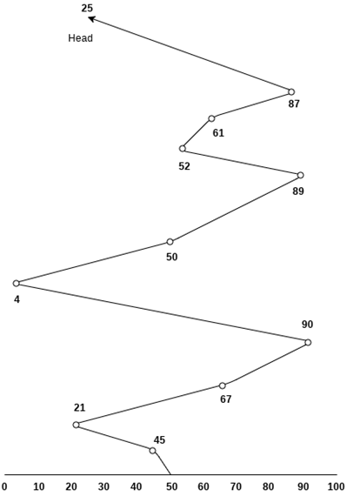
Disk Scheduling algorithms
First Come First Serve (FCFS)
In this algorithm, the requests are served in the order they come. Those who come first are served first. This is the simplest algorithm. Eg. Suppose the order of requests are 45, 21, 67, 90, 4, 50, 89, 52, 61, 87, 25 Head pointer starting at 50
Seek Time = Distance Moved by the disk arm = 5 + 24 + 46 + 23 + 86 + 46 + 49 + 9 + 26 + 62 = 376
Department of Information Technology, VIIT, Pune-48

Slide 58
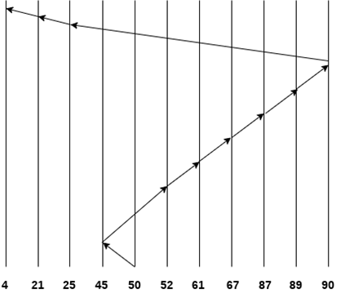
Disk Scheduling algorithms
SSTF Scheduling Algorithm
Shortest seek time first (SSTF) algorithm selects the disk I/O request which requires the least disk arm movement from its current position regardless of the direction. It reduces the total seek time as compared to FCFS.
Consider the following disk request sequence for a disk with 100 tracks and Head at 50 and 45 is the only process at start.
45, 21, 67, 90, 4, 89, 52, 61, 87, 25
Seek Time = Distance Moved by the disk arm = 5 + 7 + 9 + 6 + 20 + 2 + 1 + 65 + 4 + 17 = 136
Department of Information Technology, VIIT, Pune-48

Slide 59
Disk Scheduling algorithms
SSTF Scheduling Algorithm – Disadvantages
It may cause starvation for some requests.
Switching direction on the frequent basis slows the working of algorithm.
It is not the most optimal algorithm.
Department of Information Technology, VIIT, Pune-48

Slide 60
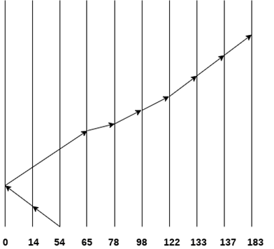
Disk Scheduling algorithms
SCAN Scheduling Algorithm
It is also called as Elevator Algorithm. In this algorithm, the disk arm moves into a particular direction till the end, satisfying all the requests coming in its path, turns back and moves in the reverse direction satisfying requests coming in its path.
It works in the way an elevator works, elevator moves in a direction completely till the last floor of that direction and then turns back.
Consider the following disk request sequence for a disk with 100 tracks Head at 54
98, 137, 122, 183, 14, 133, 65, 78
40 + 14 + 65 + 13 + 20 + 24 + 11 + 4 + 46 = 237
Department of Information Technology, VIIT, Pune-48

Slide 61
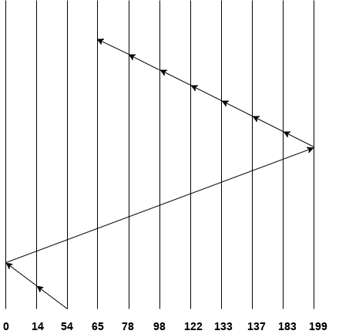
Disk Scheduling algorithms
C SCAN Scheduling Algorithm
In C-SCAN algorithm, the arm of the disk moves in a particular direction servicing requests until it reaches the last cylinder, then it jumps to the last cylinder of the opposite direction without servicing any request then it turns back and start moving in that direction servicing the remaining requests.
Consider the following disk request sequence for a disk with 100 tracks Head at 54
98, 137, 122, 183, 14, 133, 65, 78
No. of cylinders crossed = 40 + 14 + 199 + 16 + 46 + 4 + 11 + 24 + 20 + 13 = 387
Department of Information Technology, VIIT, Pune-48

Slide 62
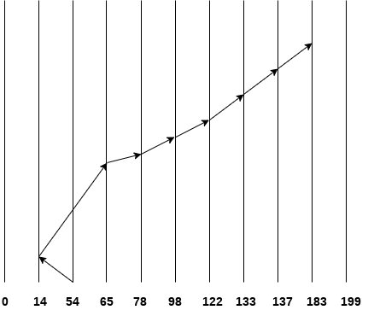
Disk Scheduling algorithms
Look Scheduling Algorithm
It is like SCAN scheduling Algorithm to some extant except the difference that, in this scheduling algorithm, the arm of the disk stops moving inwards (or outwards) when no more request in that direction exists.
This algorithm tries to overcome the overhead of SCAN algorithm which forces disk arm to move in one direction till the end regardless of knowing if any request exists in the direction or not.
Consider the following disk request sequence 98, 137, 122, 183, 14, 133, 65, 78
Number of cylinders crossed = 40 + 51 + 13 + +20 + 24 + 11 + 4 + 46 = 209
Department of Information Technology, VIIT, Pune-48

Slide 63
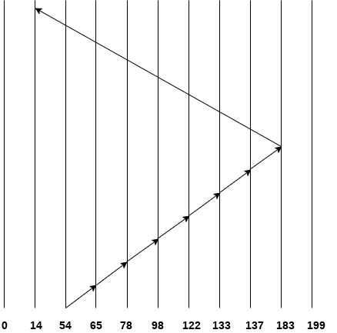
Disk Scheduling algorithms
C Look Scheduling Algorithm
C Look Algorithm is similar to C-SCAN algorithm to some extent. In this algorithm, the arm of the disk moves outwards servicing requests until it reaches the highest request cylinder, then it jumps to the lowest request cylinder without servicing any request then it again start moving outwards servicing the remaining requests.
It is different from C SCAN algorithm in the sense that, C SCAN force the disk arm to move till the last cylinder regardless of knowing whether any request is to be serviced on that cylinder or not. Consider the requests - 98, 137, 122, 183, 14, 133, 65, 78
Number of cylinders crossed = 11 + 13 + 20 + 24 + 11 + 4 + 46 + 169 = 298
Department of Information Technology, VIIT, Pune-48

Slide 64
End of Unit 4….
Department of Information Technology, VIIT, Pune-48

